Slide 1
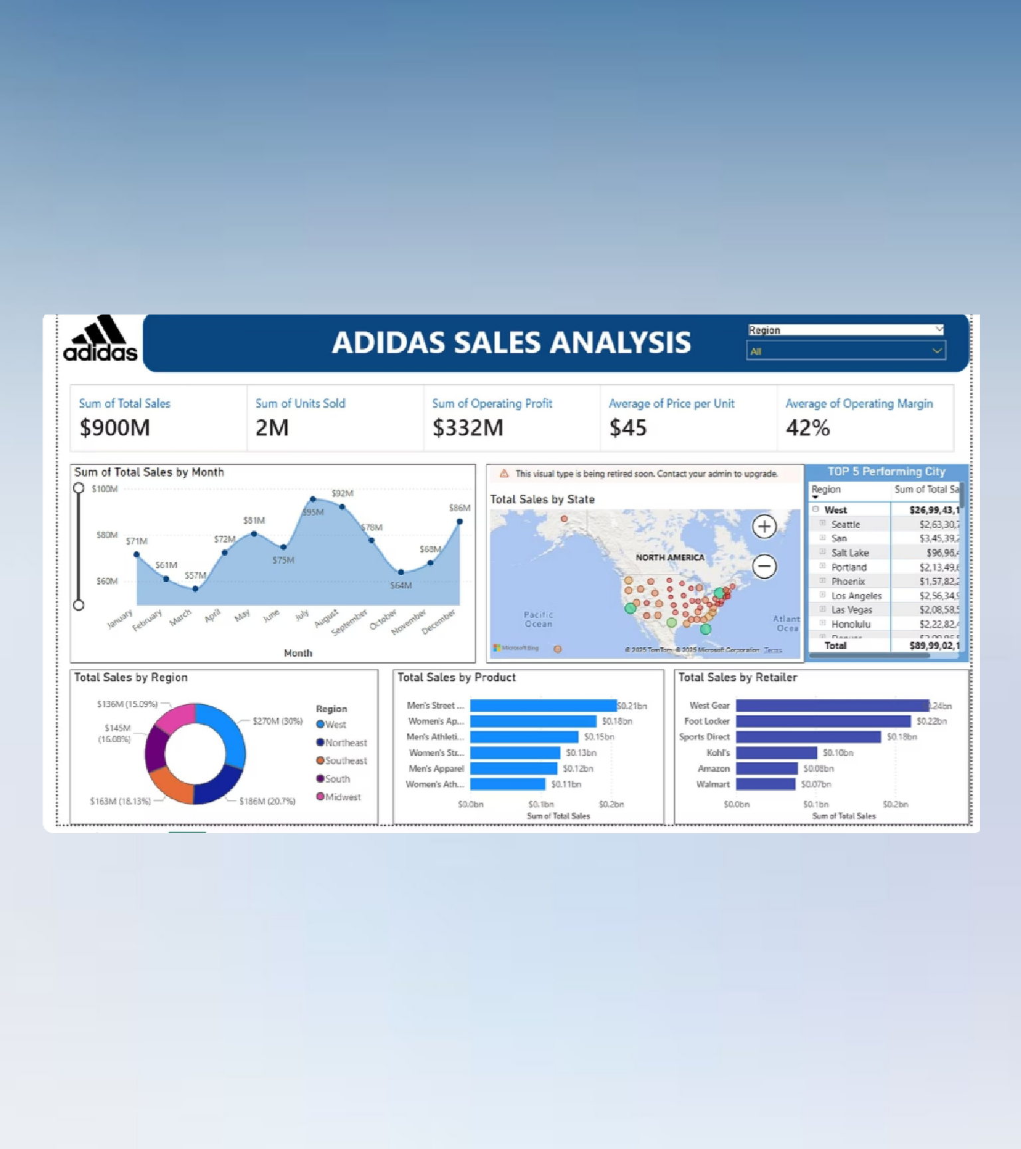
ADIDAS SALES ANALYSIS
Power BI Retail Performance Dashboard

Slide 2
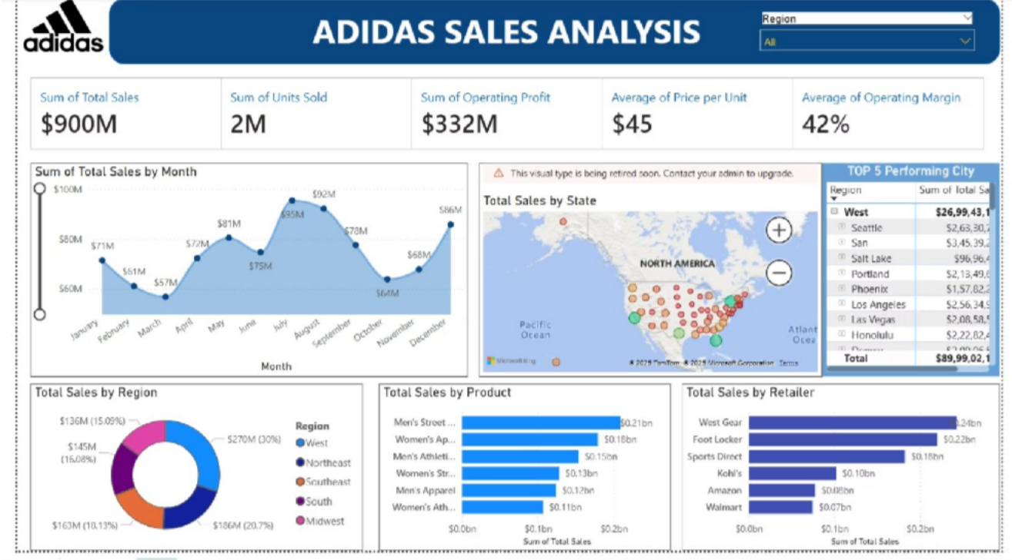

Project Overview: Understanding Adidas US Sales Data
Objective
About the Dataset
The aim of this project is to analyze Adidas’s sales performance across the United States and identify important patterns in revenue, profit, product demand, and regional performance. The goal is to help understand what drives sales and where improvements can be made.
The analysis is based on the Adidas US Sales Dataset obtained from Kaggle.It includes real retail sales records such as product types, retailers, prices, units sold, operating profit, and sales regions.

Slide 3





Fulfilling Business Requirements
This analysis addresses critical business needs by providing a clear, data-driven perspective on Adidas's operational performance.
Overall Sales Performance
Get a clear view of sales trends to understand which areas are growing and where there may be issues.
Regional Performance Analysis
Identify which states or regions are doing well and which are not, so marketing and distribution efforts can be focused in the right places.
Product Performance Analysis
Find out which products bring the most sales and profit, helping with better inventory planning and product decisions.
Data-Driven Pricing & Margin Strategies
Use insights to set better prices and increase profit across all products.
Actionable Recommendations
Turn the data into clear and practical steps that can help improve sales and increase overall business profit.

Slide 4
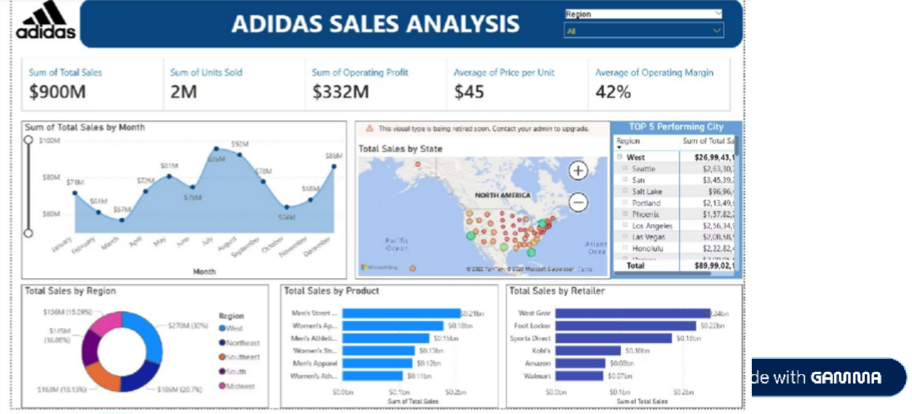
Problem Statement
To effectively analyse and present Adidas US sales data, specific visual and quantitative requirements were established.
Key Chart Requirements Essential KPI Requirements
Total Sales by Month
Total Sales
Visualised as an Area Chart to show trends over time.
Total Sales by State
Operating Profit
Represented by a Filled Map for geographical performance insights.
Units Sold
Total Sales by Region
Illustrated with a Donut Chart to show proportional contributions.
Average Price per Unit
Total Sales by Product
Operating Margin
Displayed as a Bar Chart for easy comparison of product categories.
Total Sales by Retailer
Presented as a Bar Chart to highlight top retail partners.

Slide 5






Dashboard Explanation: Navigating the Adidas Sales Performance
The Power BI dashboard provides an interactive and intuitive interface for exploring key sales metrics and visualisations.
KPIs at a Glance
Immediate overview of crucial metrics like Total Sales, Operating Profit, and Units Sold.
Monthly Trend Analysis
Visualises sales performance over time, highlighting seasonal patterns and growth trajectories.
State-wise Map
Regional Contribution
Geographical breakdown of sales, enabling targeted regional strategies.
A donut chart illustrating the proportional sales contribution from each major region.
Product Sales Performance
Bar charts detailing sales across different product categories, identifying top sellers.
Retailer Sales Breakdown
Insights into individual retailer performance, supporting partnership optimisation.

Slide 6
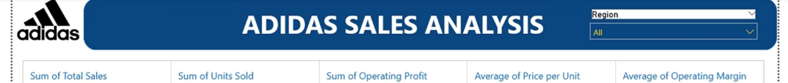

Key Insights: Uncovering Performance Drivers
Our analysis reveals compelling trends and performance highlights from the Adidas US sales data.
$900M
Strong Revenue
2M
Units Sold
$332M
High Operating Profit
Total sales demonstrating robust market presence.
Volume of products successfully distributed.
Significant profitability, indicating efficient operations.
Top Product: Men’s Street Footwear ($0.21B)
Men's Street Footwear is the highest-grossing product category.
Top Retailer: West Gear ($0.24B)
West Gear stands out as the most successful retail partner.
Highest Sales Region: West (30%)
Best Monthly Performance: August ($92M)
The Western region leads in sales contribution, underscoring its importance.
August recorded the highest monthly sales, indicating peak demand.
2
3
1
4

Slide 7

Conclusion: Supporting Better Data Decisions
This Adidas US Sales Analysis project provides a clear and useful way to understand sales performance and find opportunities to improve retail results.
Data-Driven Insights Improve Strategy
Using data helps create better and smarter business strategies.
Optimized Retail Operations
The insights help improve retail processes such as inventory management and sales planning.
Real-Time Decision-Making with Power BI
The dashboard shows updated data, making it easier to take quick and accurate decisions.
Strong Understanding of Performance
It provides a clear view of how different regions and products are performing, helping to plan improvements and growth.

Slide 8


Thank You

